Slide 1
Convolutional Neural Networks
Santanu Sarker

Slide 2

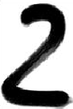
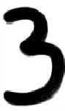
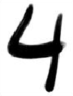
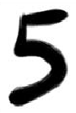
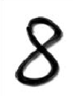
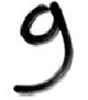
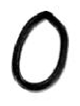
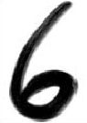
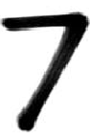
The problem

Slide 3
The problem
Original
Rotated
Scaled
Skewed

Slide 4
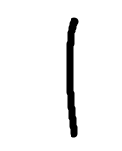
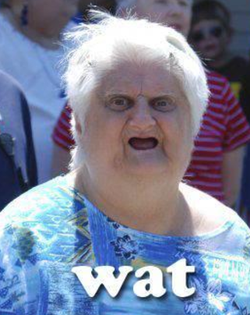
The problem
Original
Rotated
Scaled
Skewed

Slide 5
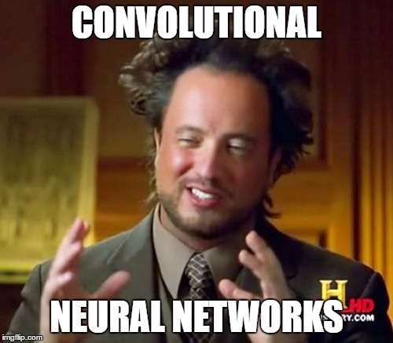
The solution

Slide 6
5 Key Concepts
Convolution
Max Pooling
Activation
Gradient Descent
Back Propagation

Slide 7

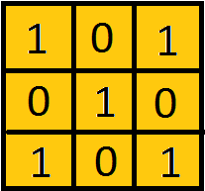
Convolution
Align the kernel with the image
Multiply each kernel value with corresponding pixel value
Add up the result
Repeat for entire image
Kernel

Slide 8

Max Pooling
Create a window (2x2)
Pick a stride length (2)
Move the window over the feature map
Take the maximum value from each window

Slide 9
Activation
Softmax
tanh
ReLU

Slide 10
Gradient Descent

Slide 11
Back Propagation

Slide 12
Lets try it out!
Source: github.com/santanu23/MachineLearning

Slide 13
Any Questions?

